Slide 1

I’d rather be
CBM retreat, May 2024

Slide 2
Shiny in R: crash course
How to develop an app?
What is a Shiny app?
Components: UI vs server
Idea
App design
Shinyuieditor
shinydashboard
Linking UI and Server
Reactive vs Observe
Putting it together
Testing and deployment
Local vs server

Slide 3
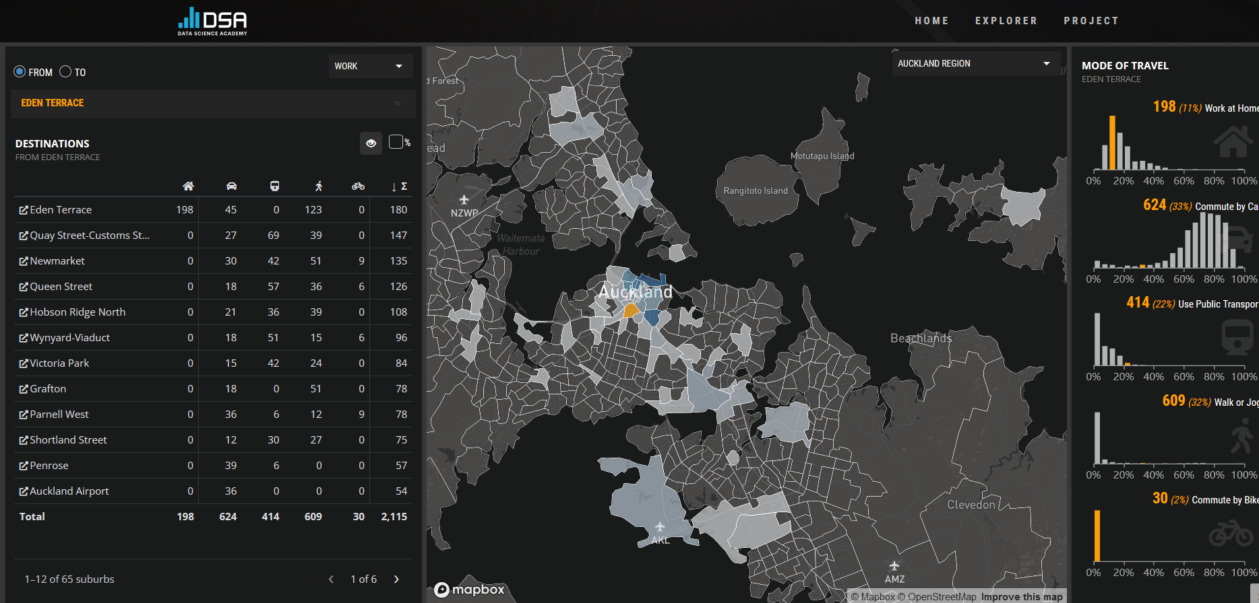
What is Shiny?
Creating web-based apps with interactivity as the central idea
Allows users to interact with a dataset to explore, analyze, test, and educate
Developed in R or Python
Run in a web-browser
Hosted locally or online
➔ An accessible way to navigate complex data

Slide 4

Components: UI vs server
User interface
Front facing
Shiny specific approach (kinda)
Server
Back end
Simple R code you’ve come to know and love!
Computations done on the remote machine, server, …

Slide 5

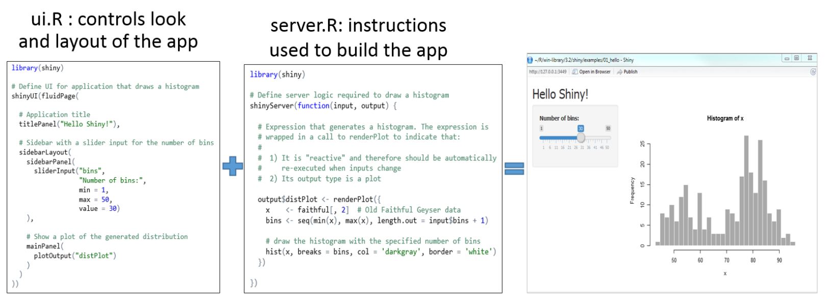

Slide 6
Shiny app typical structure
One R script file: app.R (or server.R and UI.R)
General steps:
Loading libraries
Loading data (optional)
Declaring the user interface
Defining the server function
Launching the app

Slide 7
Shiny app typical structure
UI structure
Defining look
Setting up inputs
Displaying outputs
Server structure
Monitoring inputs
Performing computations
Creating outputs

Slide 8
Shiny app typical commands
UI commands
xxxInput( inputId = "…", label = "…" , …)
xxxOutput( outputId = "…", … )
Server commands
input$inputId
output$XXX <- renderXXX({ … })

Slide 9
Idea
What’s on your mind?
What data are you going to use?
What do you want to show/share?
What options/controls do you want the user to have?
How is the user going to interface with the app?
Movies
IMDB database
Plots, summary tables, random movie selection
Ratings, year, genre…
UI design, look, and feel

Slide 10
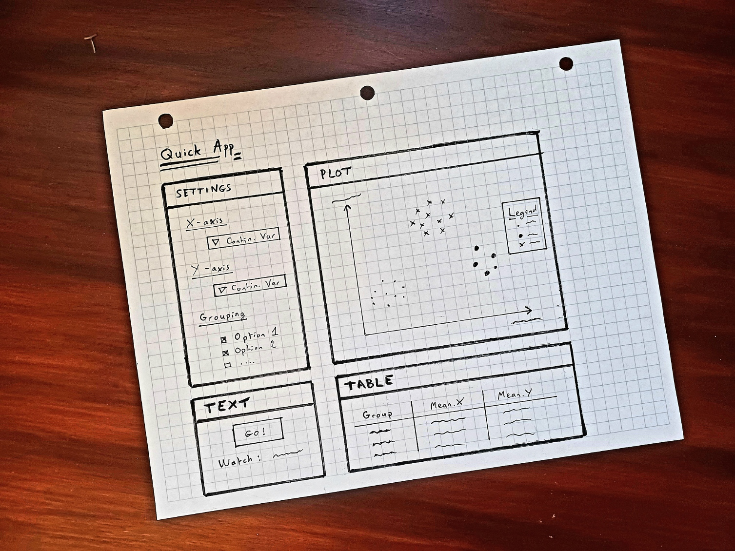
App design prototyping

Slide 11

User interface

Slide 12
App design
Directly
Shinyuieditor
Shinydashboard

Slide 13
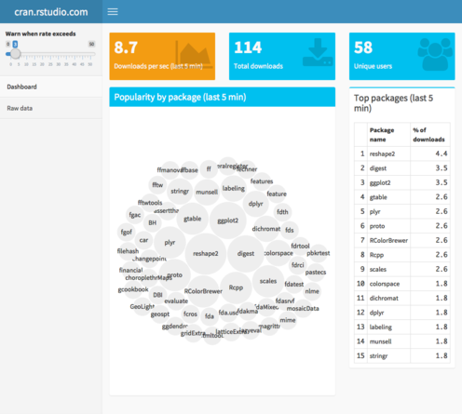
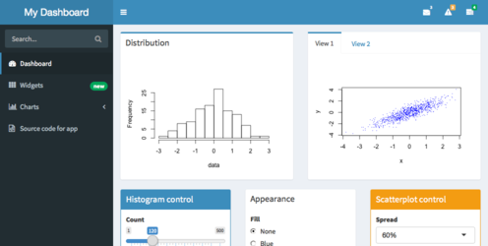
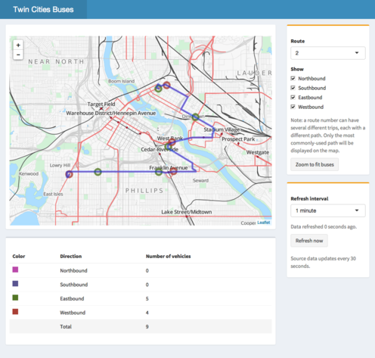
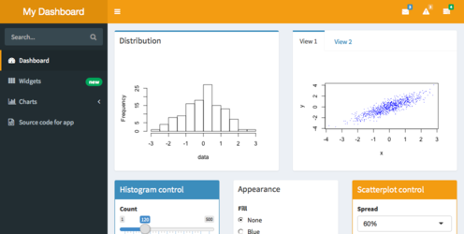
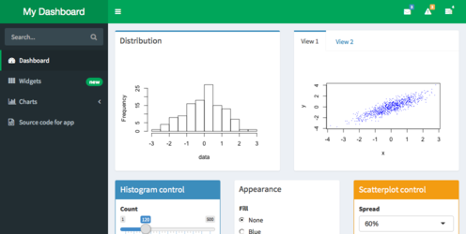
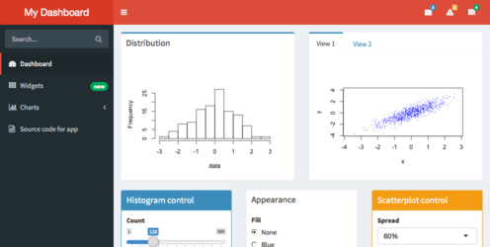
App design
New tools that are making shiny even easier to use:
Easy dashboards: Shinydashboard

Slide 14
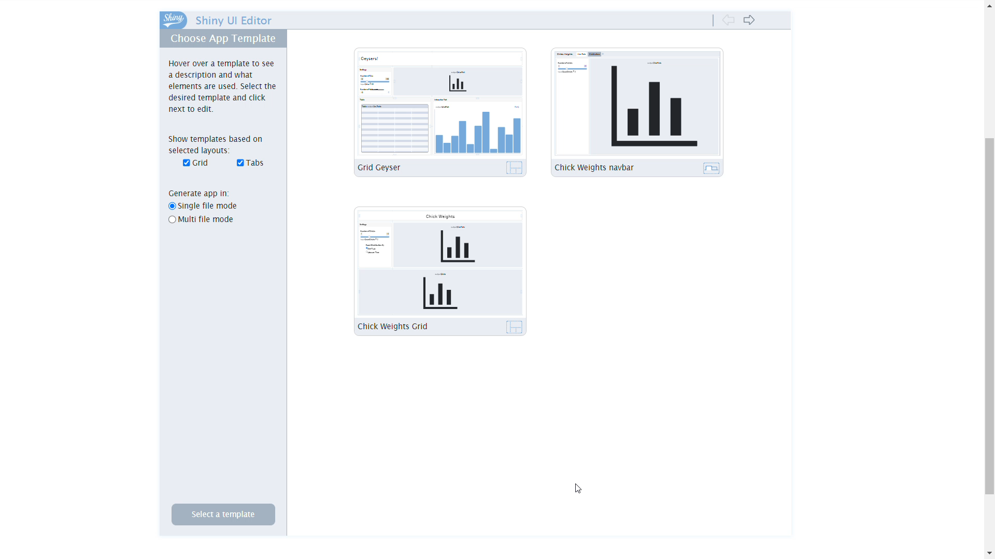
App design
New tools that are making shiny even easier to use:
Easy User Interface Editor: shinyuieditor

Slide 15
App design : shinyuieditor
library(tidyverse)
library(shiny)
library(DT)
library(shinyuieditor)
launch_editor(“app_path")

Slide 16
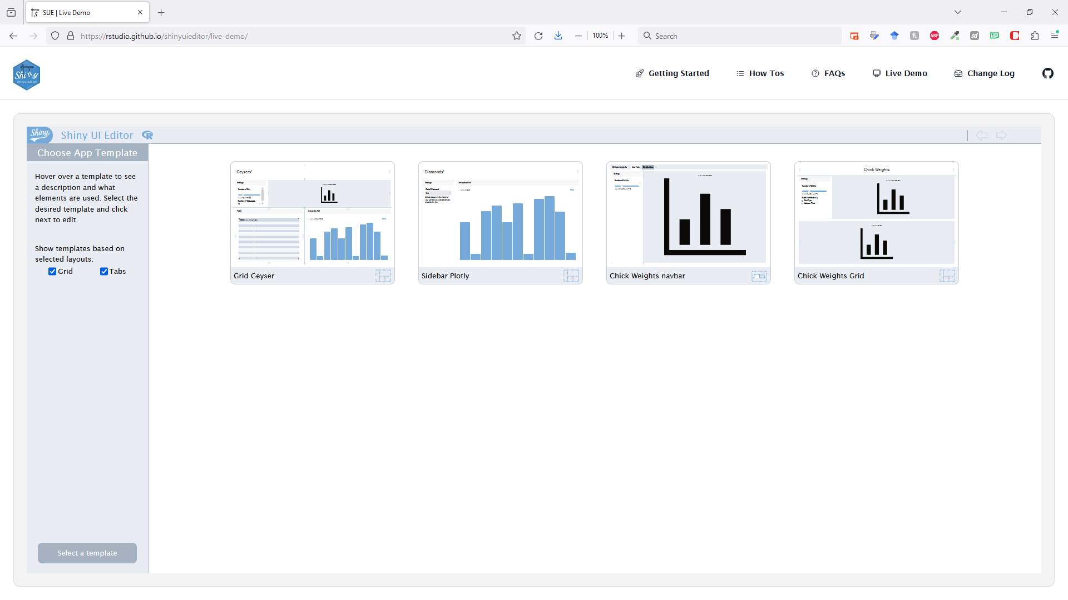
App design : shinyuieditor
Online demo option !

Slide 17
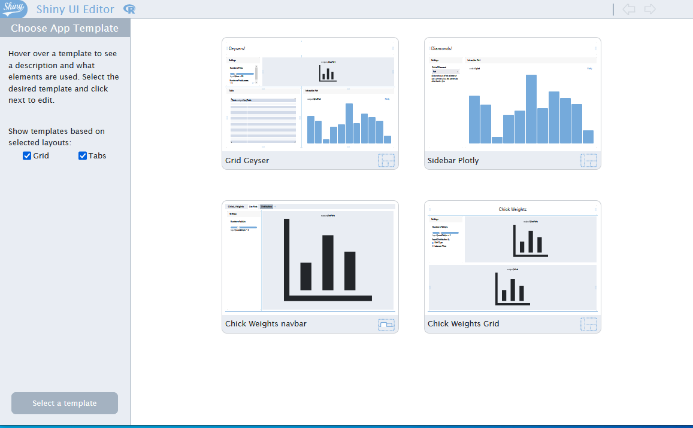
App design : shinyuieditor
Select template

Slide 18
App design : shinyuieditor
Select template

Slide 19
App design : shinyuieditor
Select template

Slide 20
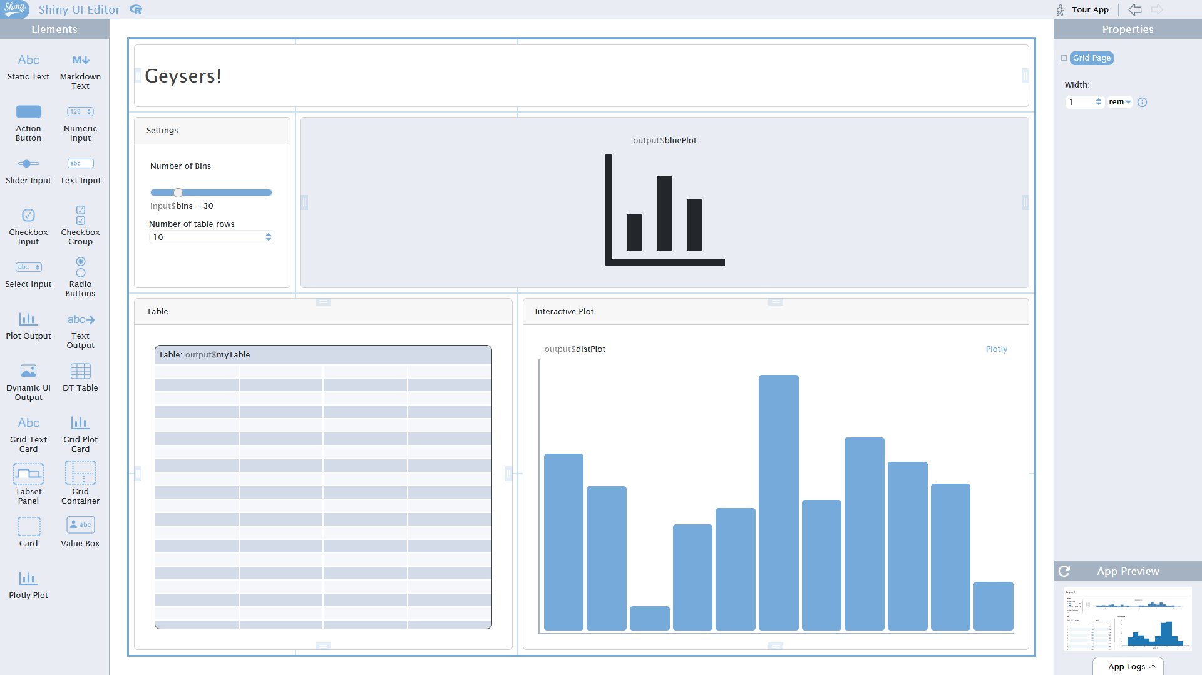
App design : shinyuieditor
Edit general layout
General structure
based on cards
area
layout
Drag-and-drop
Delete elements

Slide 21
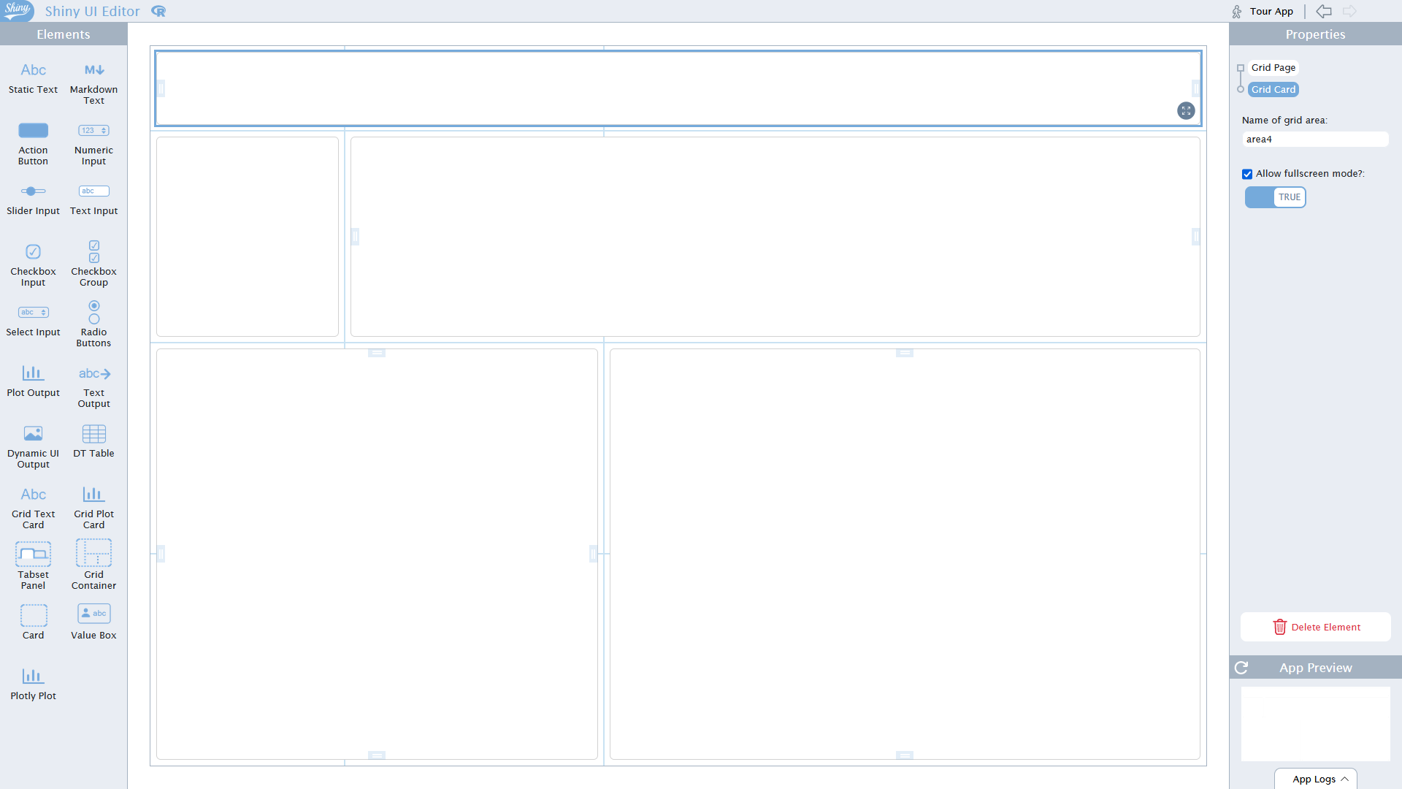
App design : shinyuieditor
Edit general layout
General structure
based on cards
area
layout
Drag-and-drop
Delete elements

Slide 22
App design : shinyuieditor
Note: doesn’t have to be card, other ways to create the general UI
absolutePanel()
conditionalPanel()
fixedPanel()
headerPanel()
inputPanel()
mainPanel()
navlistPanel()
sidebarPanel()
tabPanel()
tabsetPanel()
titlePanel()
wellPanel()
sidebarLayout()
fluidPage()
navbarPage()
fluidRow()
Edit general layout
General structure
based on cards
area
layout
Drag-and-drop
Delete elements

Slide 23
App design : shinyuieditor
Edit general layout
General structure
based on cards
area
layout
Drag-and-drop
Delete elements
ui <- grid_page(
layout = c(
"header header",
"sidebar plotly",
"recommend table "
), ...

Slide 24
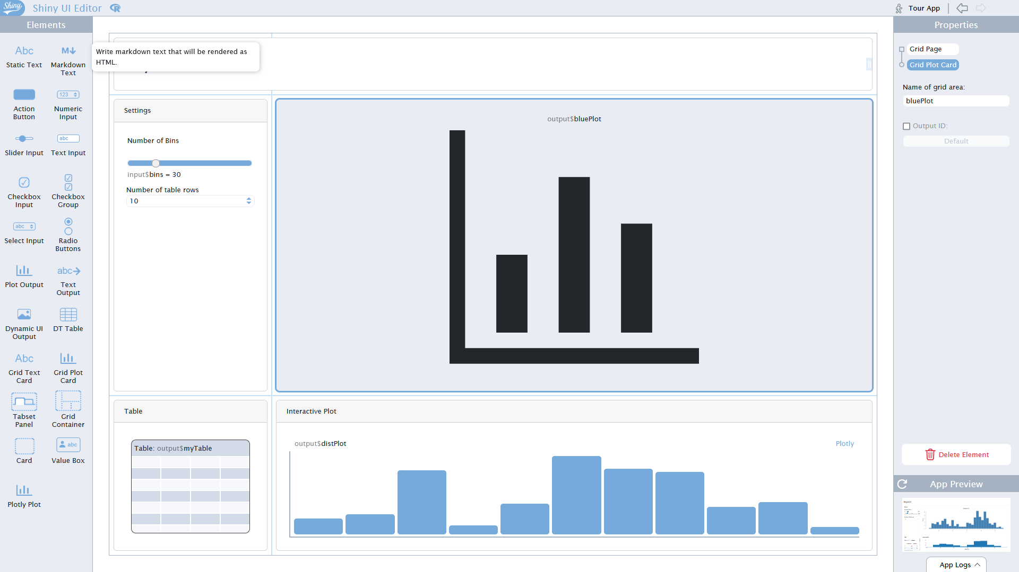
App design : shinyuieditor
Edit general layout
General structure
based on cards
area
layout
Drag-and-drop
Delete elements

Slide 25
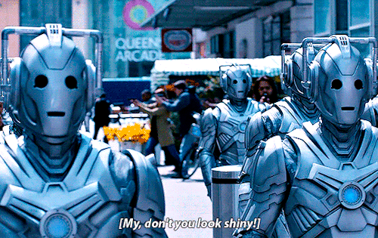

Slide 26
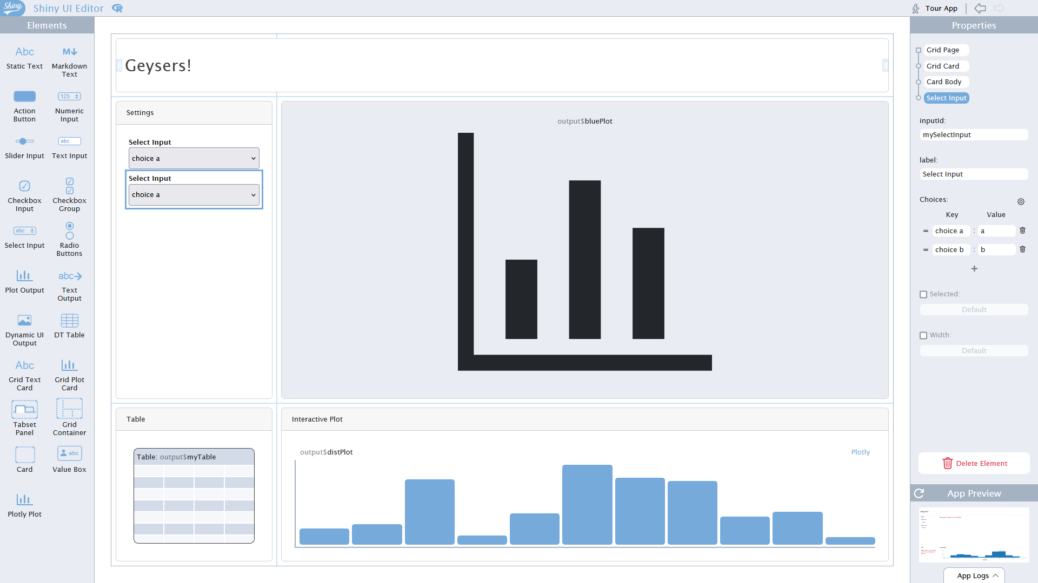
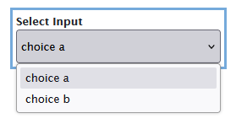
shinyuieditor : drop down menu
selectInput()
name
label
Possibility to set multiple
selectInput(inputId = "input.x",
label = "X-axis",
choices = list("Rating" = "Rating", "Year" = "Year", "Duration" = "Duration", "Genre" = "Genre"),
selected = "Year“
)

Slide 27
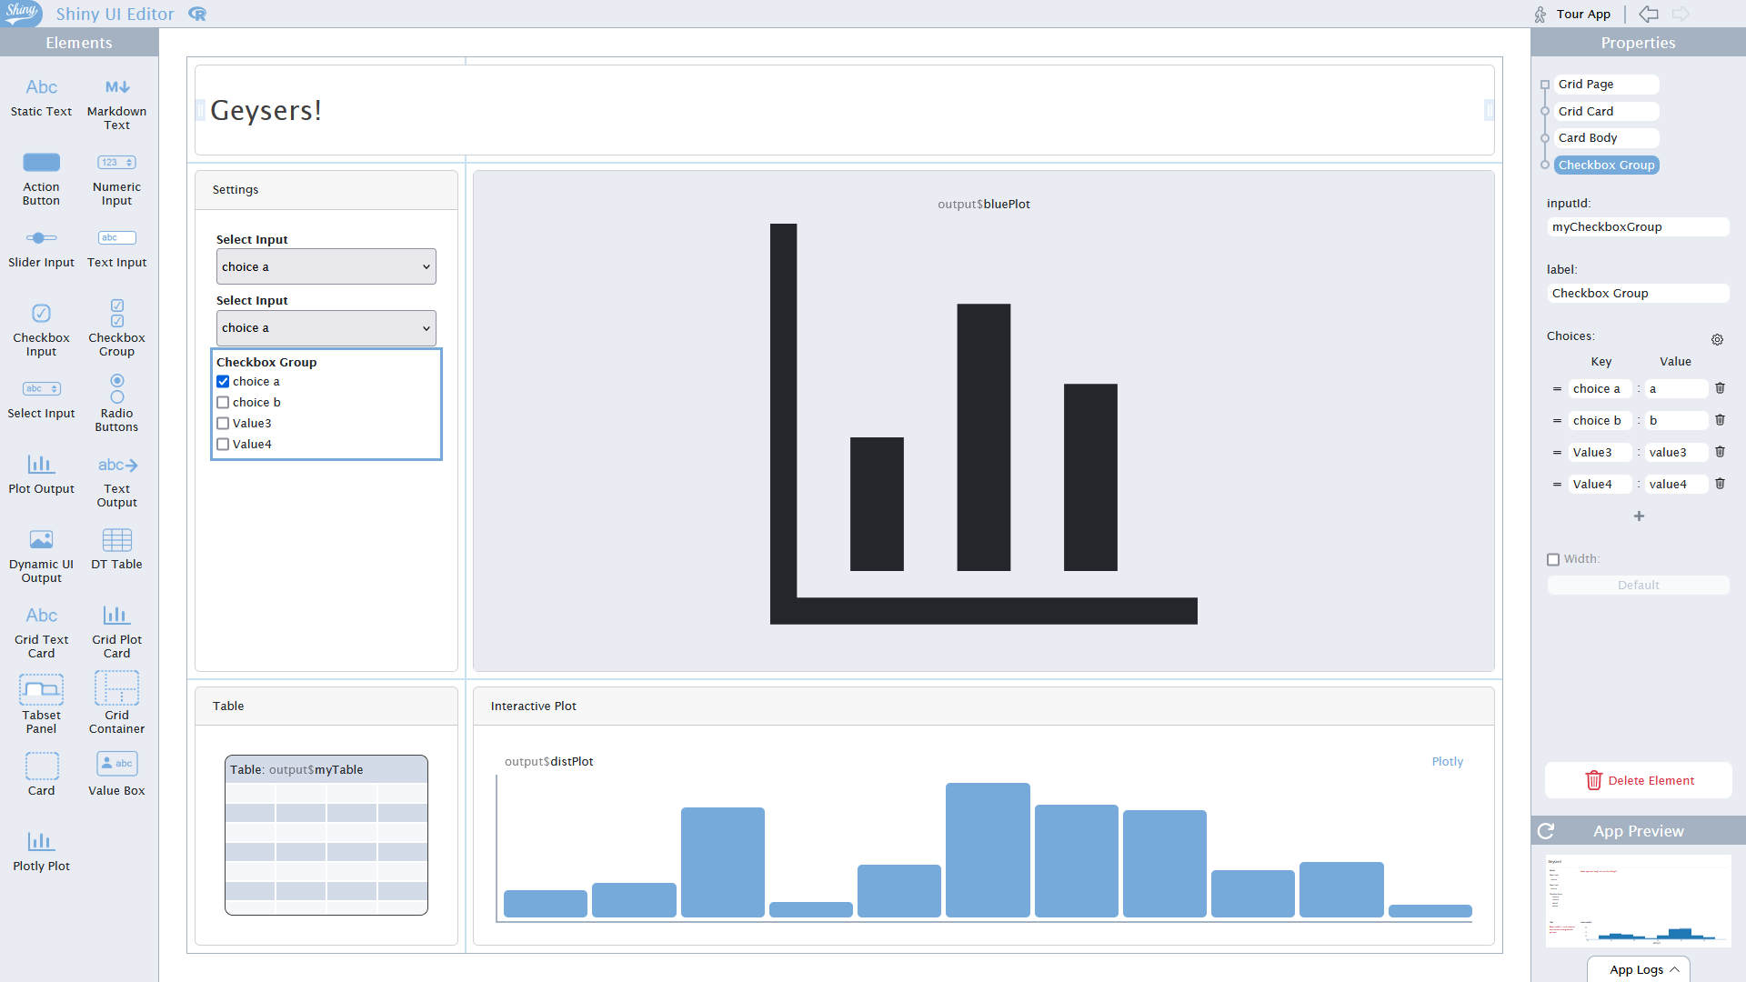
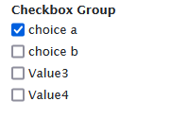
shinyuieditor : checkboxes
checkboxGroupInput()
Note: Editing the code directly can be easier if a lot of options
checkboxGroupInput(inputId = "input.g",
label = "Genre",
choices = genre.list,
selected= genre.list)

Slide 28
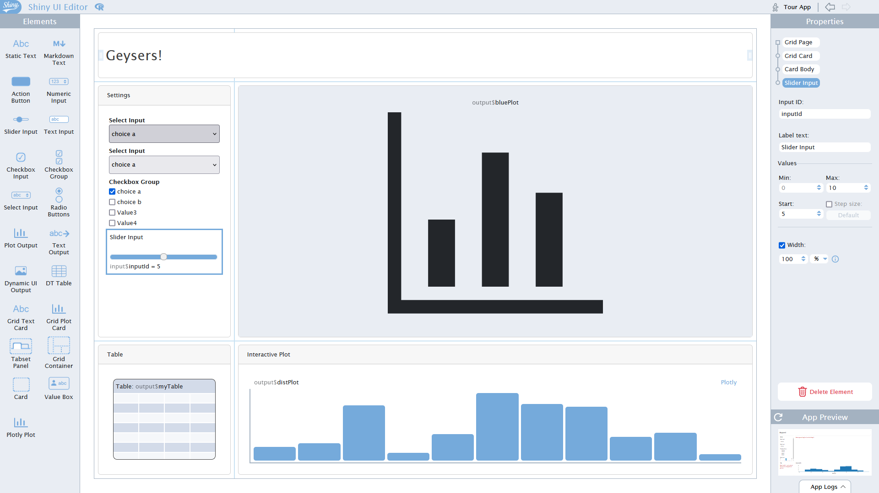
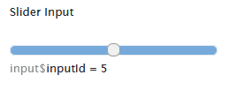
shinyuieditor: slider
sliderInput()
By default, one value
For range, need to edit UI code manually
Setting up options with a vector, editing UI code
sliderInput(inputId = "input.r",
label = "Rating",
min = 0, max = 10, value = c(0,10),
width = "100%", step = 0.1)

Slide 29
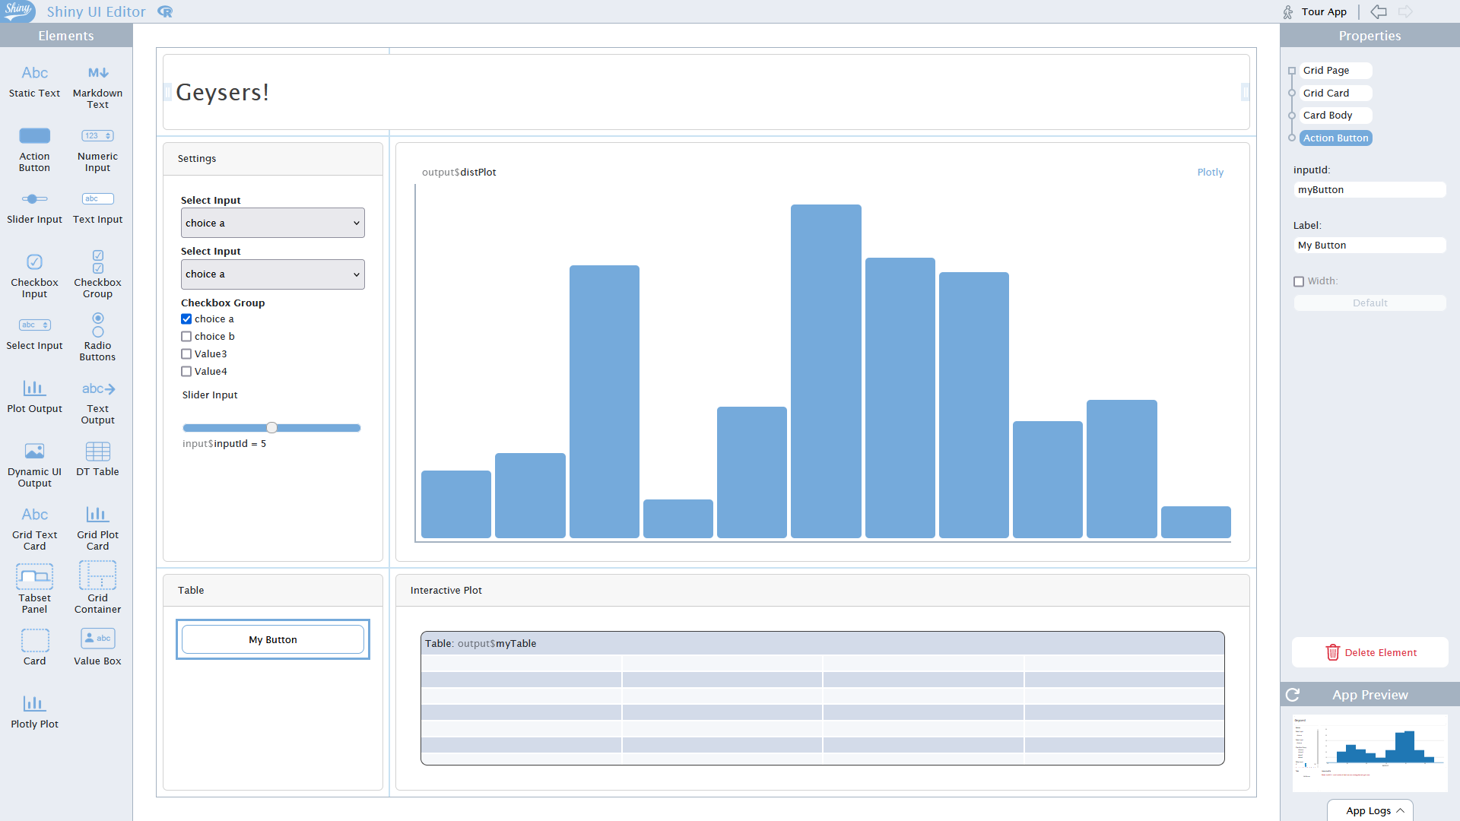
shinyuieditor: action button
actionButton()
actionButton(inputId = "random",
label = "Recommend!")

Slide 30


Slide 31
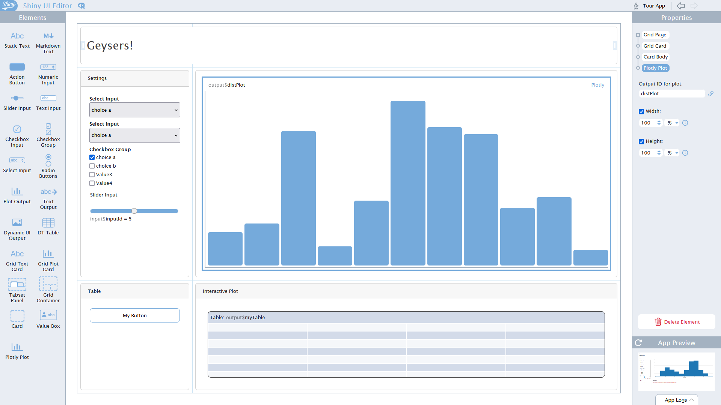
shinyuieditor: output plot
ggplot2 / base plots:
plotOutput()
Plotly :
plotlyOutput()
plotlyOutput(outputId = "distPlot",
width = "100%", height = "100%")

Slide 32
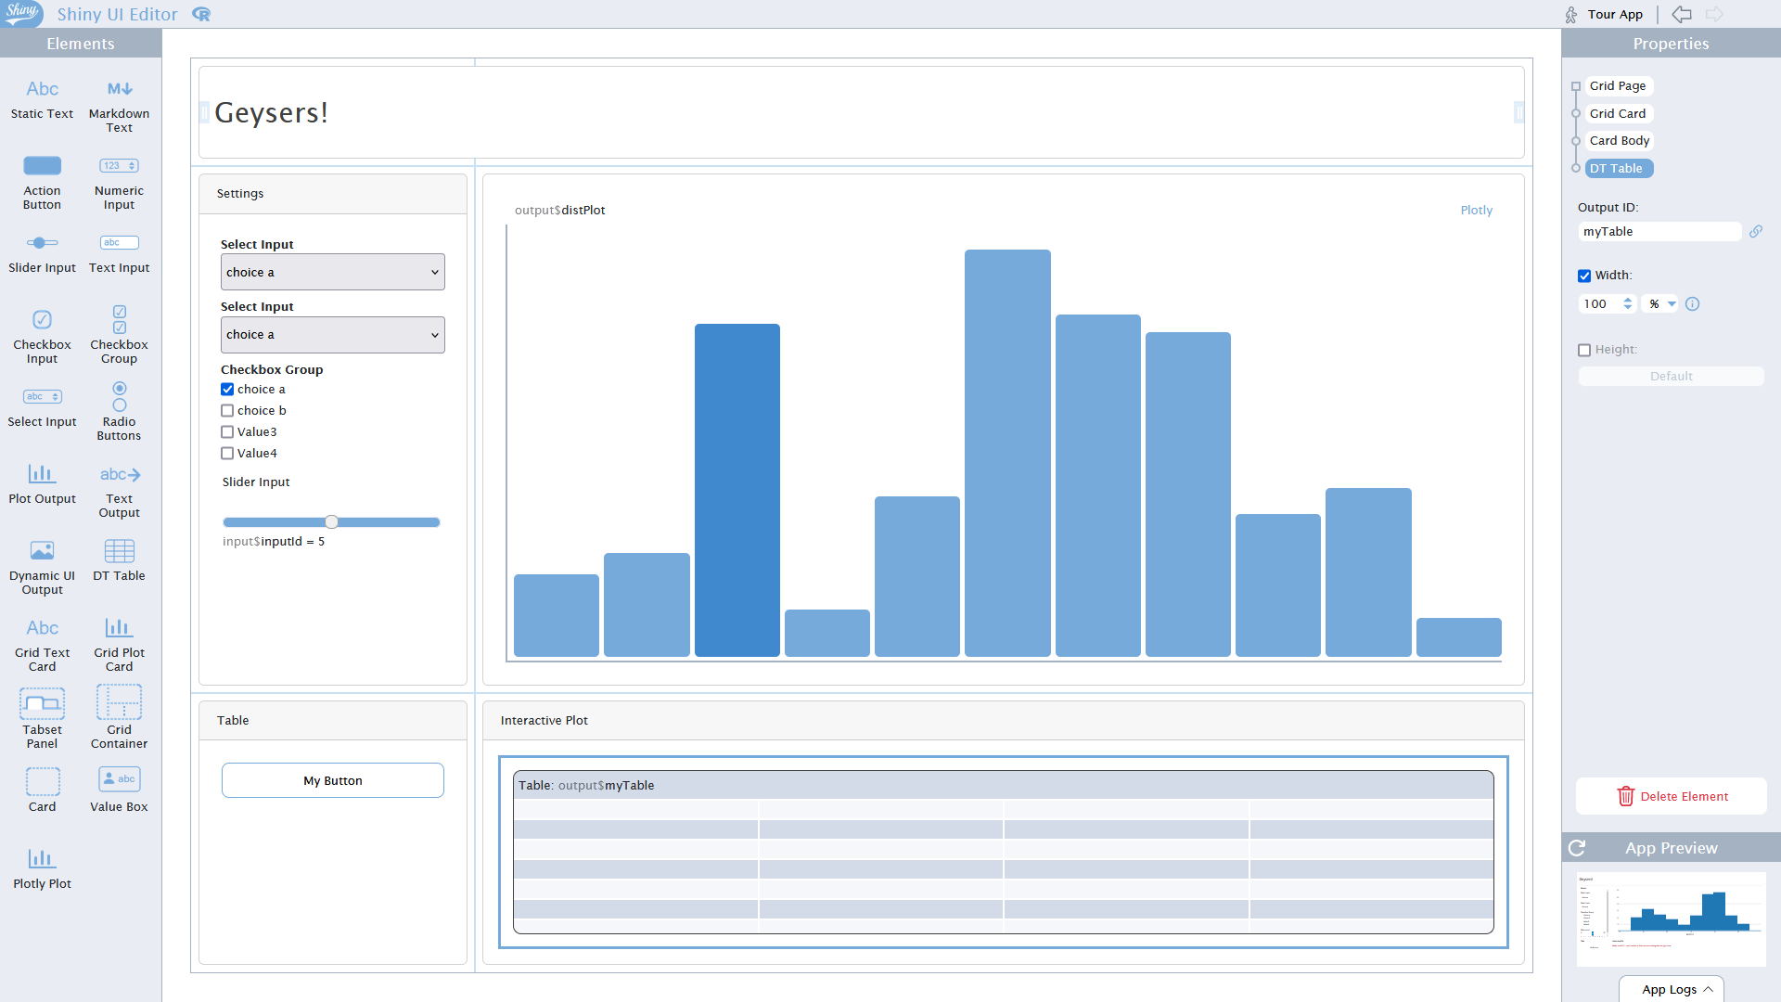
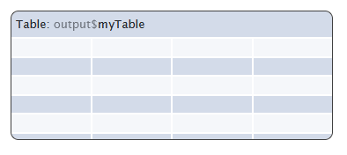
shinyuieditor: output table
DTOutput()
DTOutput(outputId = "myTable",
width = "100%")

Slide 33
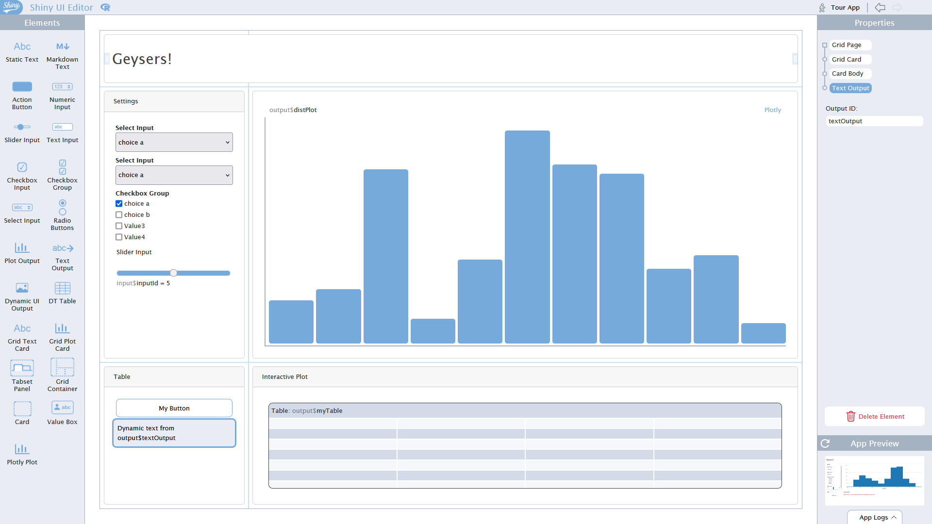
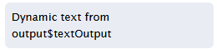
shinyuieditor: output text
textOutput()
textOutput(outputId = "textOutput")

Slide 34
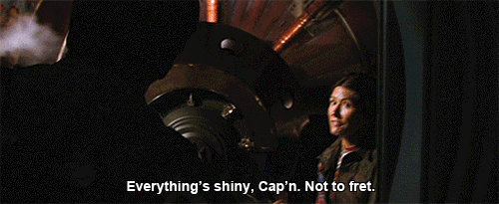
Editing UI in the code

Slide 35
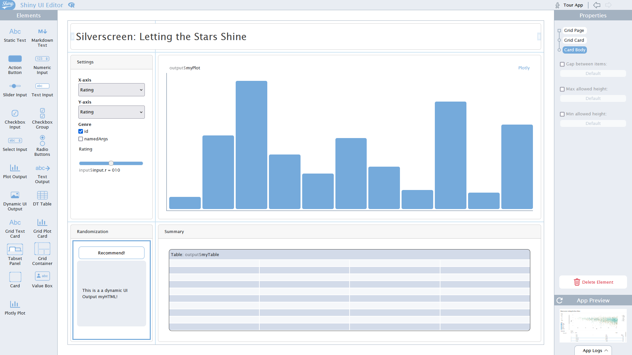

Slide 36

Server

Slide 37
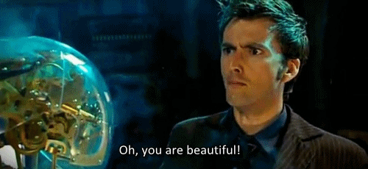
Linking UI and Server
Bringing the input from the UI to the server
Perform computations
Return output

Slide 38
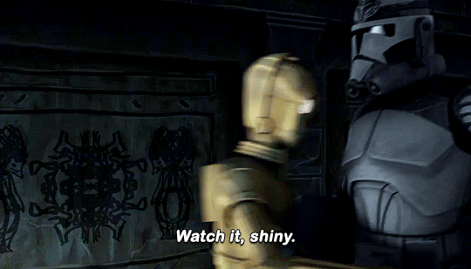

Slide 39
Server side: reactive data
Interactivity : reactive vs observe vs observeEvent
reactive : for calculations, automatically re-perform computation when input changes. Used to perform calculations, transformations, or any sort of data manipulation. Results usually get called somewhere else in the code.
observe : for actions, never stops "observing" and updates the input as soon as the other changes. Yields no output and can't be used as an input to other reactive expressions. Only useful for their "side effects", such as I/O, triggering a pop-up, and so on.
observeEvent : needs the user to make an action to run the code inside. Sometimes you want to wait for a specific action to be taken from the user, like clicking an actionButton(), before calculating an expression or taking an action.
reactive.data <- reactive({ … })
reactive.data()

Slide 40
Server side: creating and exporting outputs
Create:
output$XYZ <- …
Render:
renderPlot / renderPlotly ({ … })
renderText ({ … })
renderDT ({ … })
renderUI ({ … })
…

Slide 41
Server side: creating a plot
ggplot2 / base plots: renderPlot({…})
output$myPlot <- renderPlot({
selectedData() %>% ggplot(aes(x =get(input$input.x),
y= get(input$input.y),
colour = Genre)) +
labs(x=input$input.x,y=input$input.y ) +
scale_colour_brewer(palette ="BrBG") +
theme_minimal() +
if(input$input.x=="Genre") {geom_boxplot()} else {geom_point()}
})

Slide 42
Server side: creating a plot
ggplot2 / base plots: renderPlot({…})
Plotly : renderPlotly ({…})
output$myPlot <- renderPlotly({
plot_ly(data=selectedData(),
x = ~ get(input$input.x), y= ~ get(input$input.y),
color= ~ Genre, colors = "BrBG" ,
text= ~ Title ,
type = ifelse(input$input.x=="Genre","box","scatter")
) %>% layout( xaxis = list(title = input$input.x) ,
yaxis = list(title = input$input.y))
})

Slide 43
Server side : creating a data frame
renderDT ({…})
output$myTable <- renderDT({
selectedData() %>% group_by(Genre) %>%
summarize(X = round(mean(get(input$input.x),na.rm=T),2),
Y = round(mean(get(input$input.y),na.rm=T),2)
) %>% datatable(colnames=c("Genre", input$input.x,
input$input.y) )
})

Slide 44
Server side : creating some text
renderText ({…})
output$myText <- renderText({
movie= selectedData()
movie= subset(movie,!is.na(Title) & !is.na(Year))
if(nrow(movie)!=0) {
movie.sel=movie[sample.int(nrow(movie),1),]
paste0("You should watch:\n\n",
movie.sel$Title,
" (",movie.sel$Year,")")
} else {"No match!"}
})

Slide 45
Server side: respond to an action
observeEvent(input$random, { … })
observeEvent( input$random,
{
output$myText <- renderText({ … })
}
)

Slide 46
Server side : sprucing it up
Server-side UI-side
renderUI ({…}) → uiOutput ({…})
➔ For example, using HTML content
output$myHTML <- renderUI({
movie= selectedData()
movie= subset(movie,!is.na(Title) & !is.na(Year))
if(nrow(movie)!=0) {
movie.sel=movie[sample.int(nrow(movie),1),]
h4("You should watch:\n\n",
a(paste0(movie.sel$Title, " (",movie.sel$Year,")"),
href = paste0("https://www.imdb.com/title/",movie.sel$tconst) ,
target="_blank" , rel="noopener noreferrer")
)
} else { h4("No match!") }
})

Slide 47
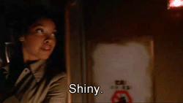

Slide 48
Putting it together
Loading libraries
Loading data
User interface
Server
Starting the app

Slide 49
shinyuieditor (again)
If needed, can go back to editing BUT …
- Comments in UI will be lost
- Sometimes risk of having the app code erased
→ BACK-UP YOUR CODE BEFORE RE-EDITING!!!!

Slide 50
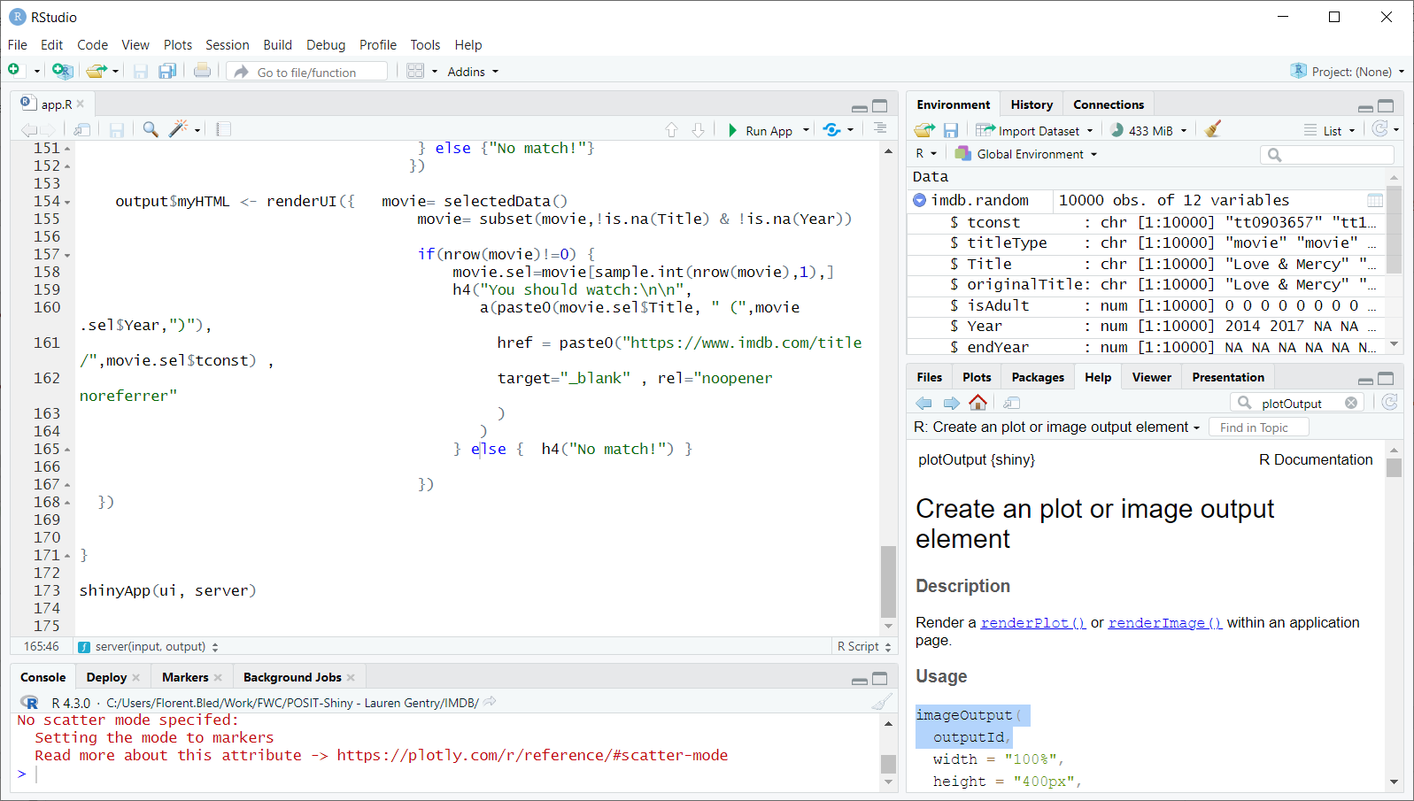
Testing and deployment
runApp()
Run app in Rstudio

Slide 51
Testing and deployment
rsconnect::deployApp()
Publish in Rstudio
shinyapps.io
FWC server

Slide 52
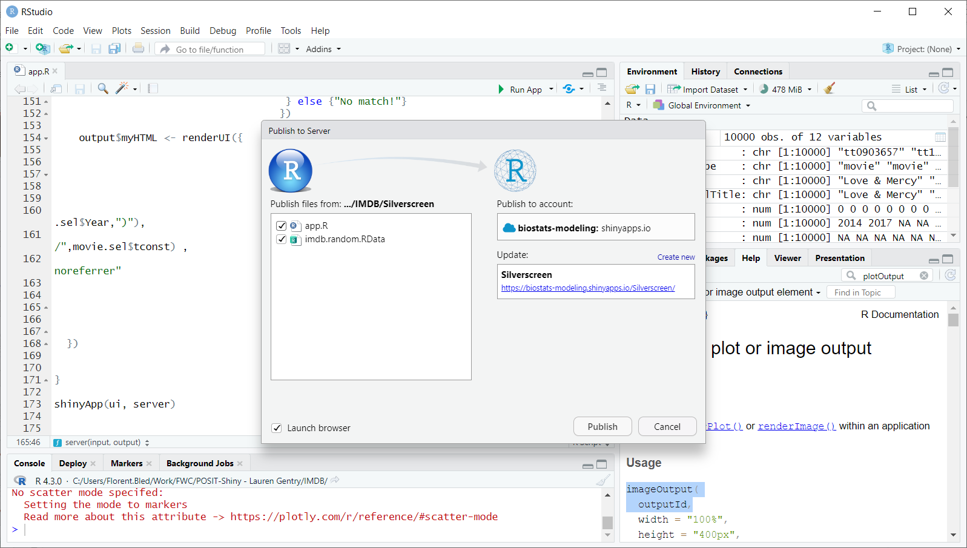
Testing and deployment
rsconnect::deployApp()
Publish in Rstudio
shinyapps.io
FWC server

Slide 53
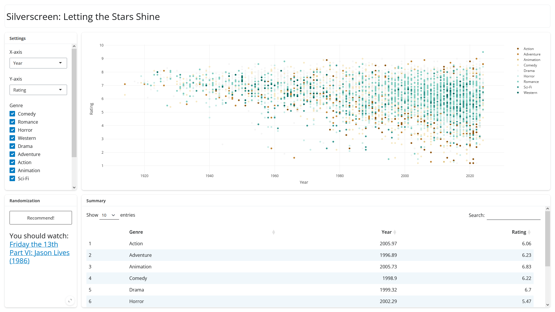

Slide 54
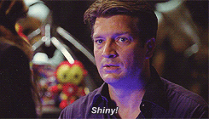

Slide 55
Additional options: input
actionLink()
checkboxInput()
dateInput() / dateRangeInput()
fileInput()
numericInput()
textInput() / passwordInput()
radioButtons()
…

Slide 56
Additional options: output
renderImage ({…}) → imageOutput ()
renderPrint ({…}) → verbatimTextOutput ()
renderDataTable ({…}) → dataTableOutput ()
renderTable ({…}) → tableOutput ()
renderUI ({…}) → htmlOutput()
renderUI ({…}) → uiOutput()

Slide 57
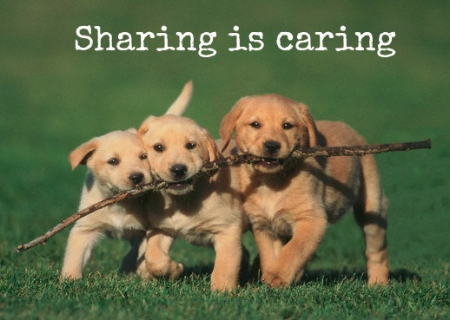
Sharing your app

Slide 58
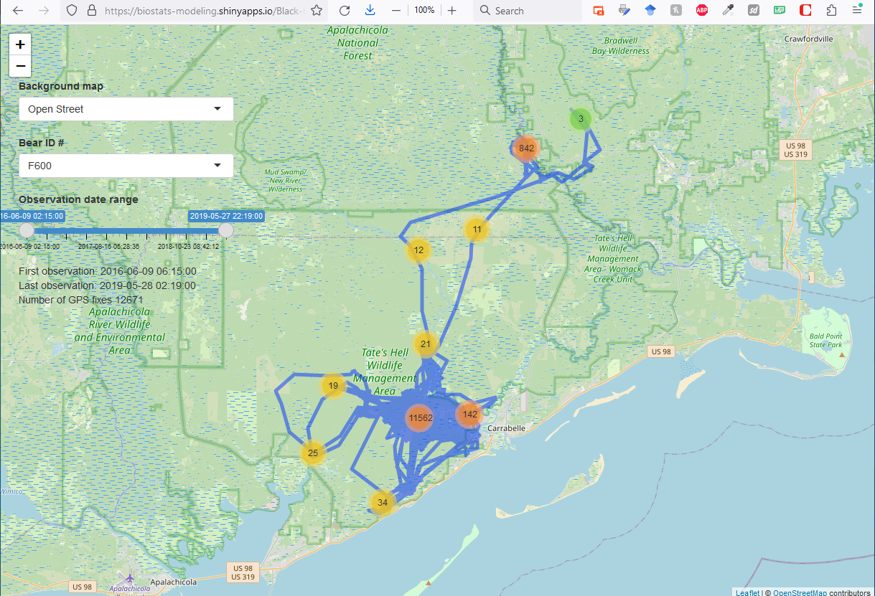
Sharing your app
Direct link

Slide 59
Sharing your app
Direct link
Embedded in iframe
<iframe height="800" width="100%" frameborder="no" src="https://biostats-modeling.shinyapps.io/Black-bear-trajectory/"> </iframe>

Slide 60
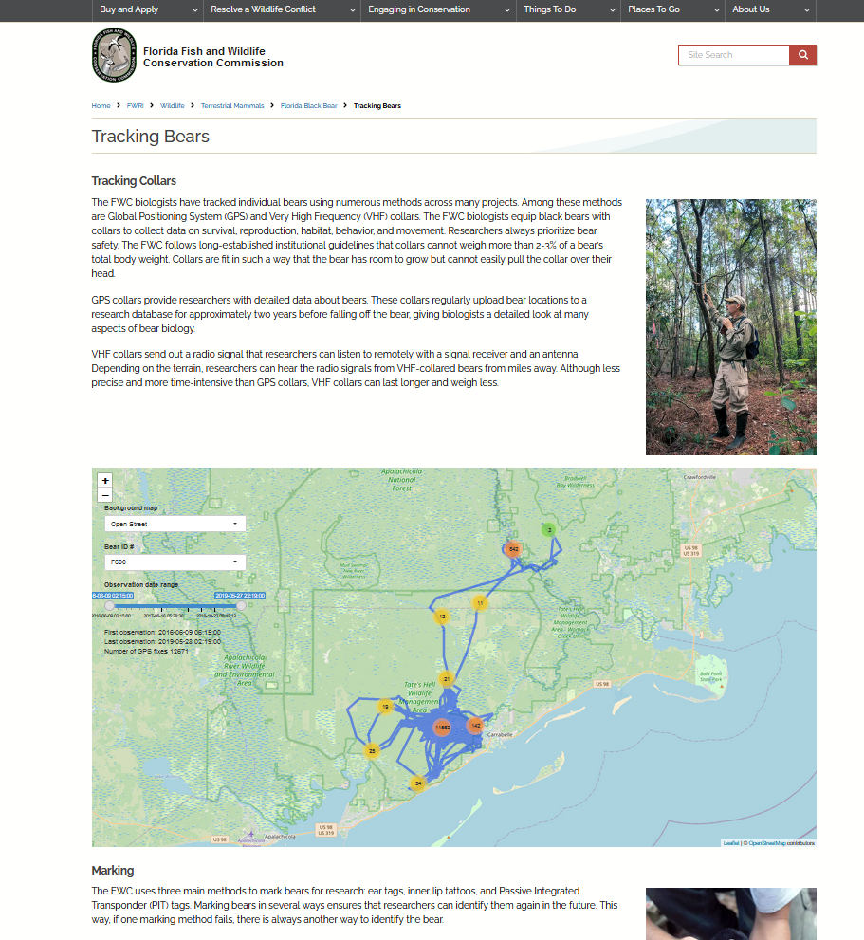
Sharing your app
Direct link
Embedded in iframe

Slide 61
Customization
Widgets
Dashboards
Tabs
HTML
CSS
Theming

Slide 62
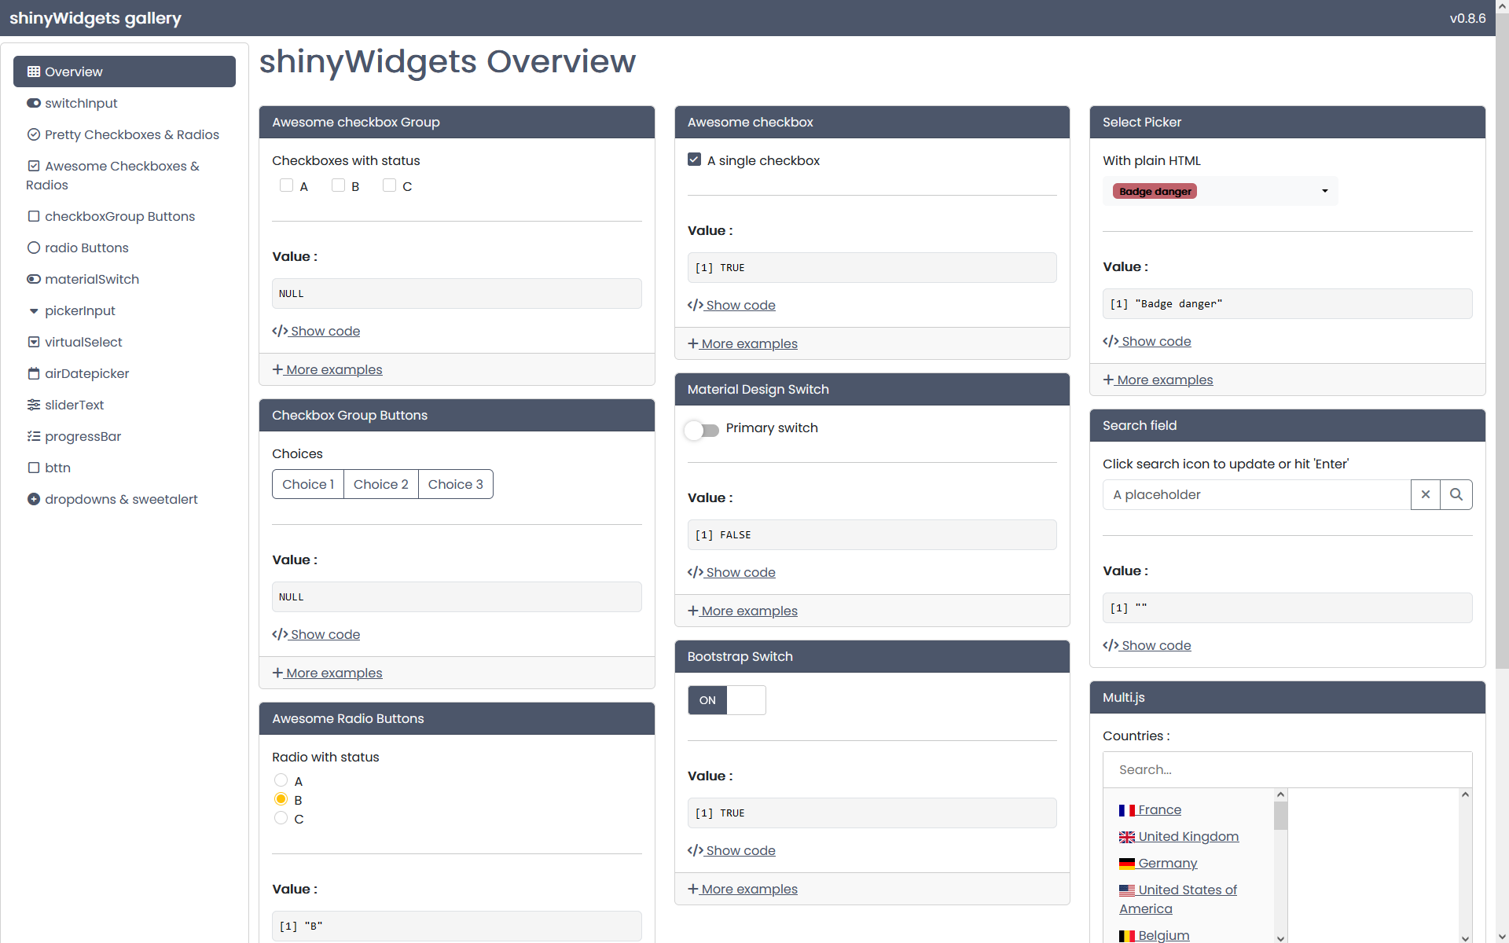
Customization: shinyWidgets
library(shinyWidgets)
library(shinydashboard)
shinyWidgetsGallery()

Slide 63
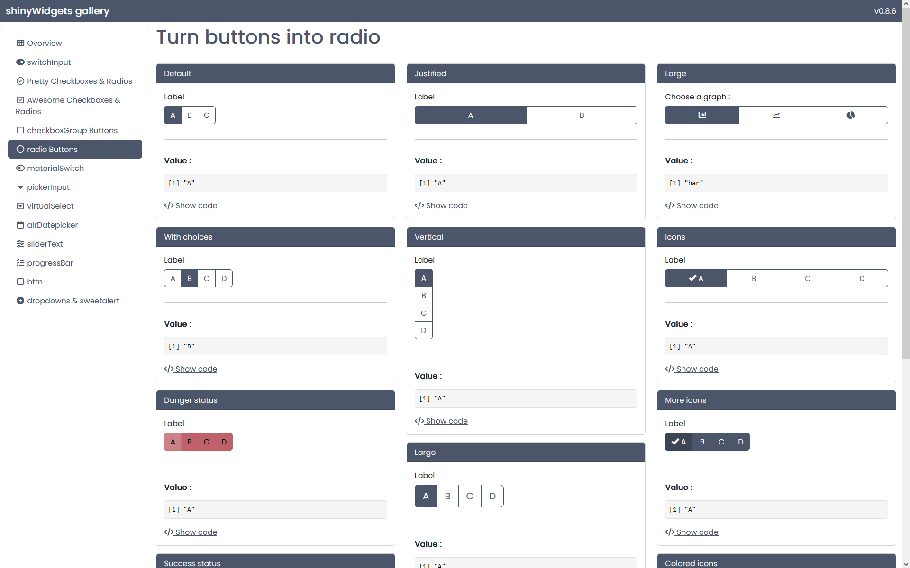
Customization: shinyWidgets
library(shinyWidgets)
library(shinydashboard)
shinyWidgetsGallery()

Slide 64
Customization: shinyWidgets
library(shinyWidgets)
library(shinydashboard)
shinyWidgetsGallery()

Slide 65
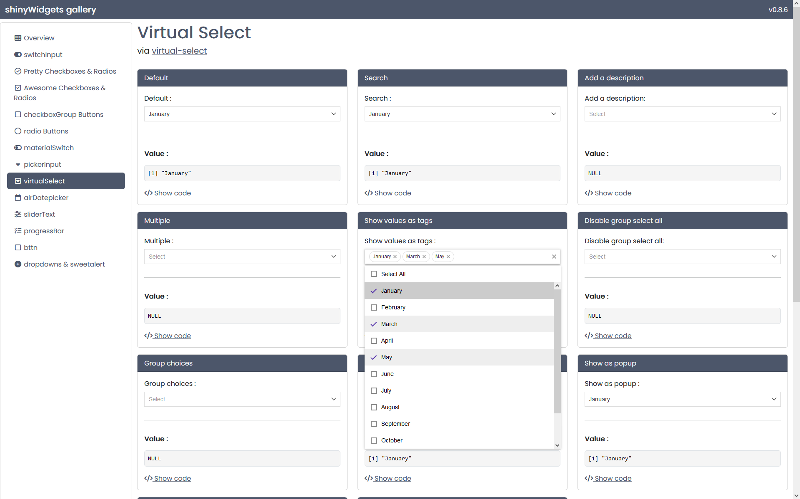
Customization: shinyWidgets
library(shinyWidgets)
library(shinydashboard)
shinyWidgetsGallery()

Slide 66
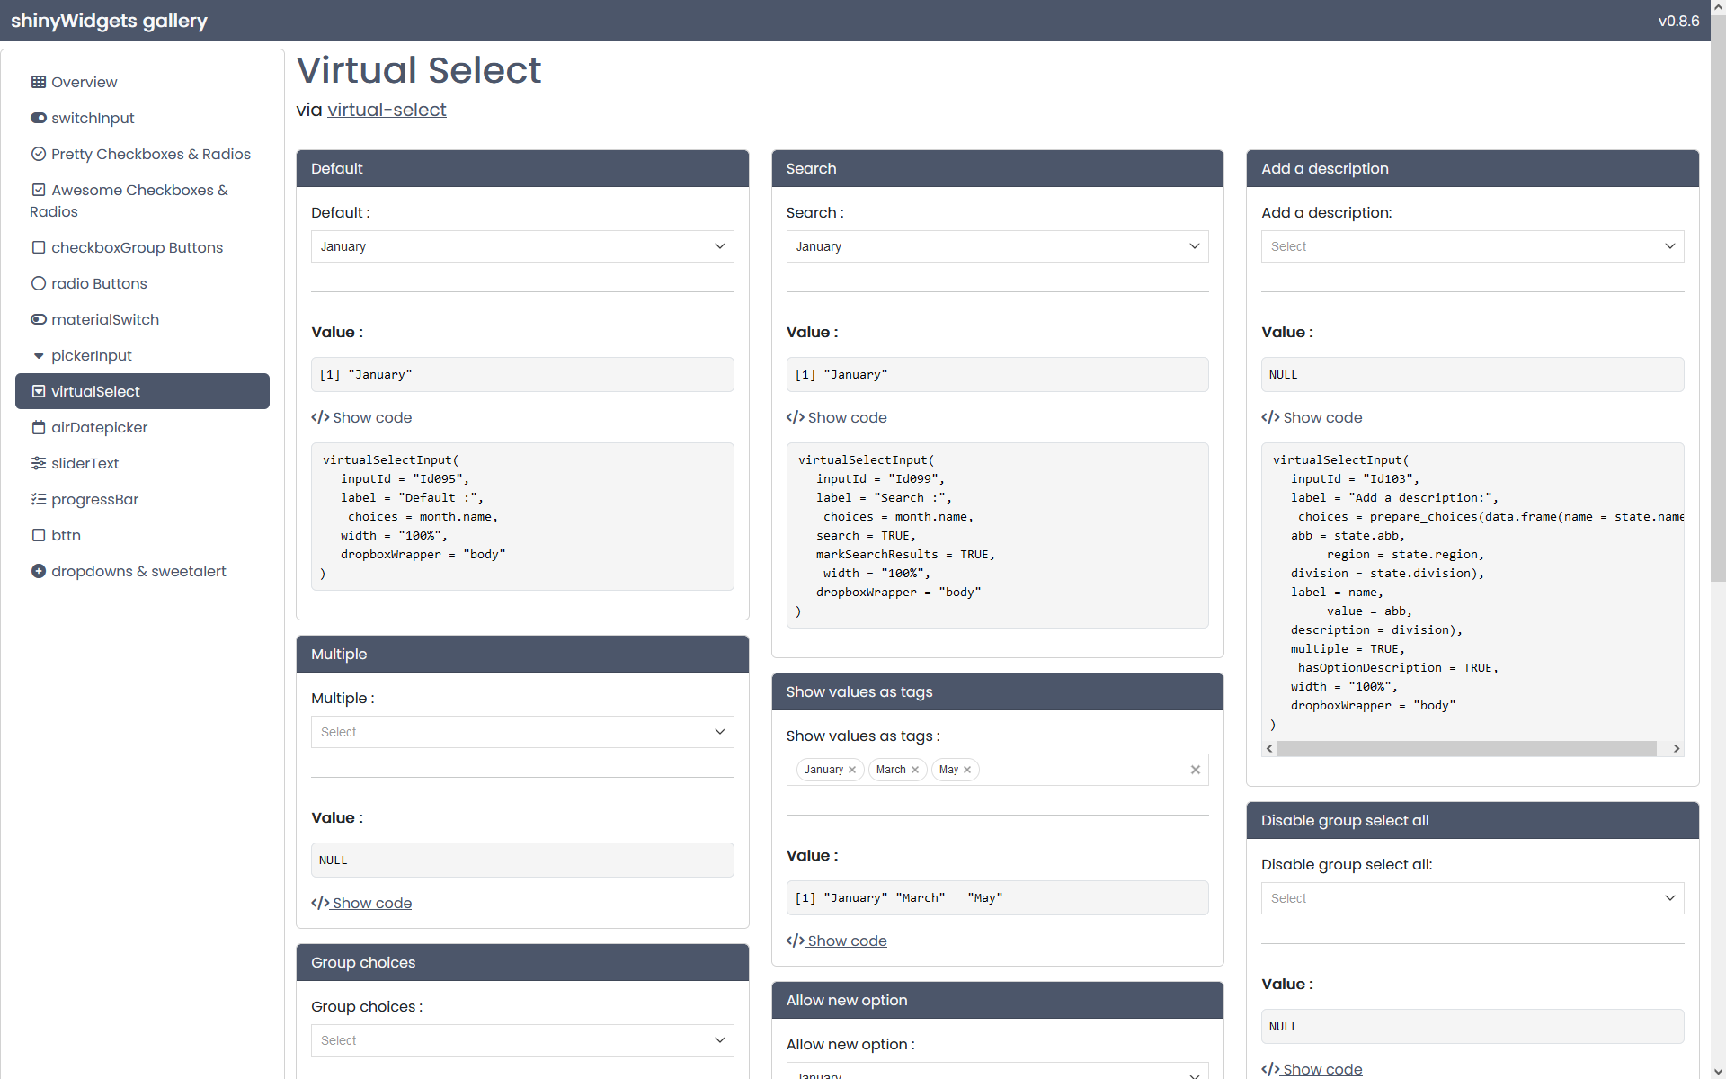
Customization: shinyWidgets
library(shinyWidgets)
library(shinydashboard)
shinyWidgetsGallery()

Slide 67
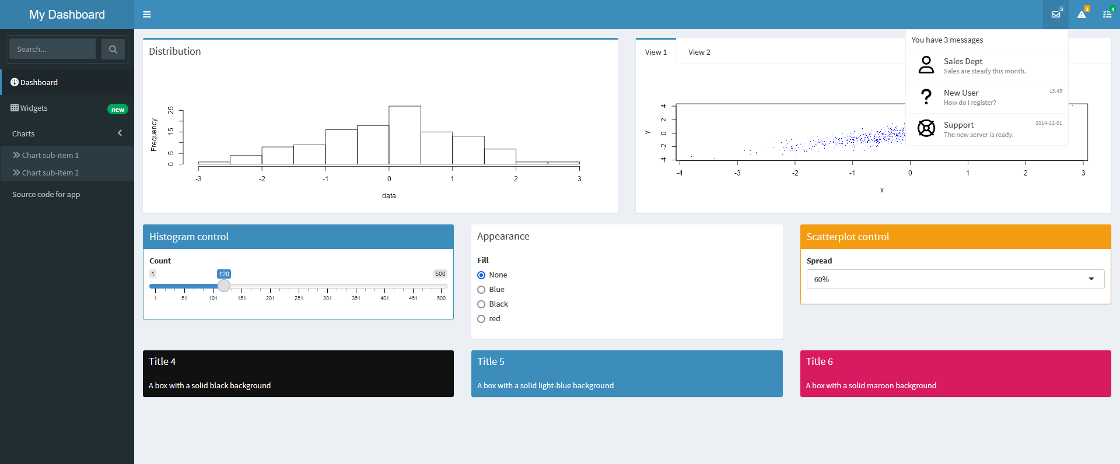
Customization: dashboards

Slide 68
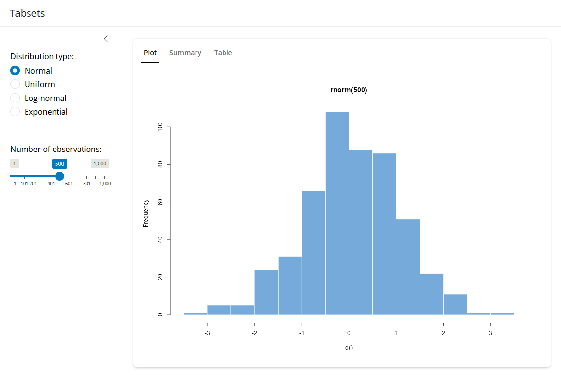
Customization: tabs

Slide 69
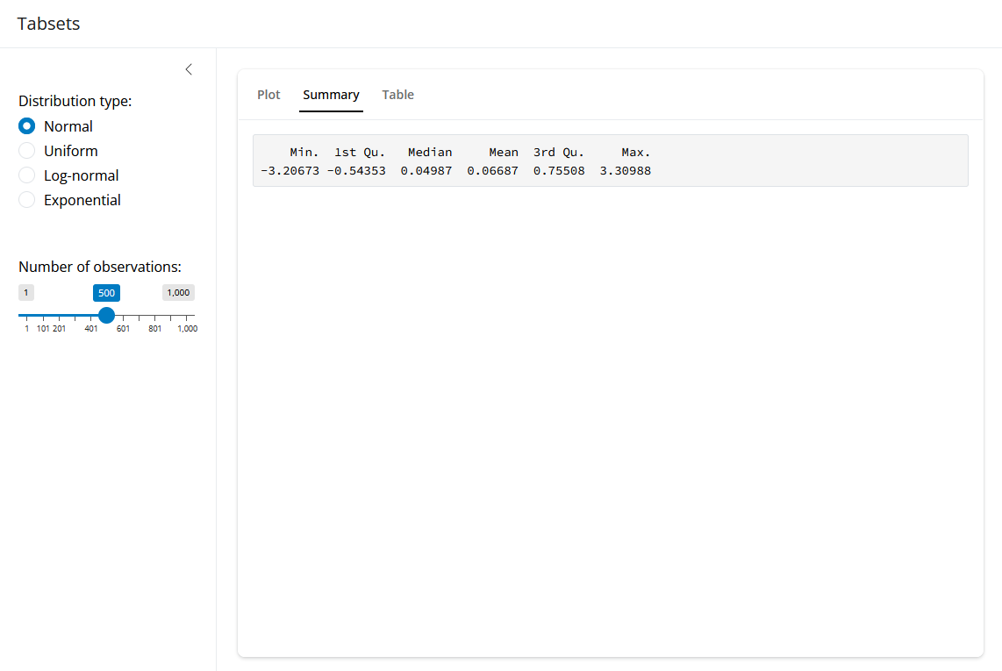
Customization: tabs

Slide 70
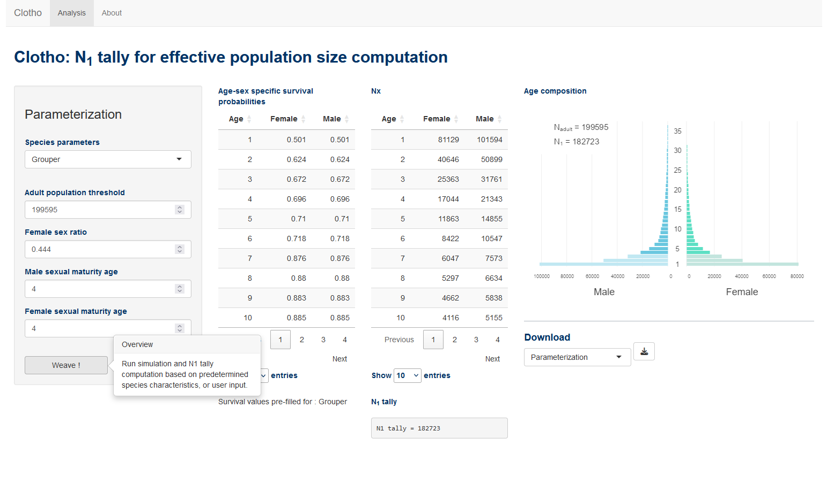
Customization: tabs

Slide 71
Customization (bonus): tooltips

Slide 72
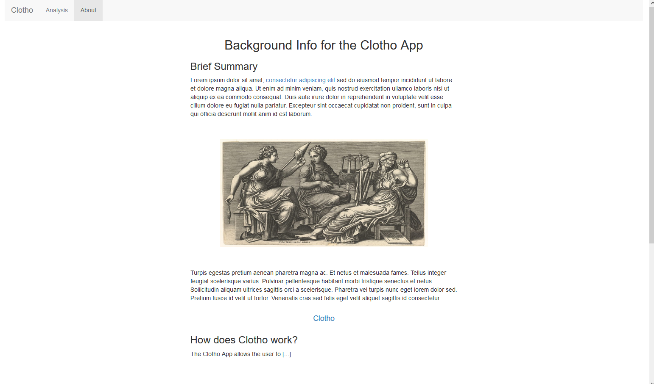
Customization: HTML

Slide 73
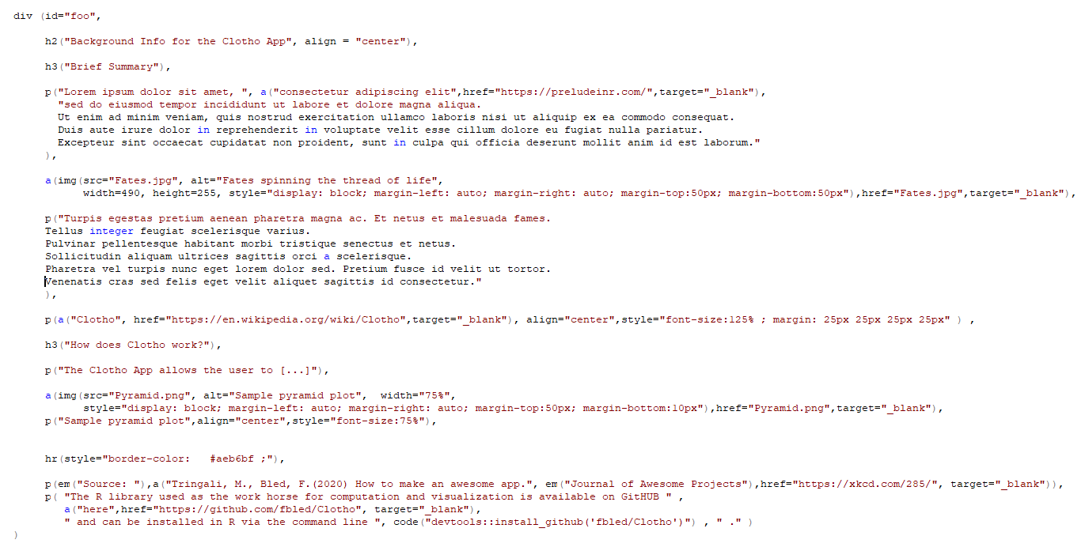
Customization: HTML

Slide 74

Customization: CSS

Slide 75
Customization: CSS

Slide 76
Customization: CSS

Slide 77

Customization: theming with bslib
library(bslib)
run_with_themer(shinyApp(ui, server))

Slide 78




Customization: theming with bslib
library(bslib)
run_with_themer(shinyApp(ui, server))

Slide 79
Customization: theming with bslib
Defining your theme
movie.theme <- bs_theme(
# Controls the default background and foreground palette
bg = "#404040", fg = "#DDD3B9",
# Controls the accent (e.g., hyperlink, button, etc) colors
primary = "#B7473C", secondary = "#940490",
# Controls the fonts
base_font = c("Myriad Pro", "sans-serif"),
code_font = c("Courier", "monospace"),
heading_font = font_collection(font_google("Abril Fatface"), "Roboto", "sans-serif")
)
# Can also add lower-level customization
movie.theme.2 <- bs_add_variables( movie.theme,
"input-border-color" = "#E3EFEF" ,
"h4-font-family" = "Myriad Pro",
"info" = "#FFFFFF“
)

Slide 80
Customization: theming with bslib
Using your theme
ui <- grid_page (
theme = movie.theme.2,
…
)

Slide 81

Customization: theming with bslib
Dark mode
input_dark_mode()

Slide 82

Customization: theming with bslib
Dark mode
input_dark_mode()

Slide 83

Customization: theming with bslib
Problem:
bslib theming works on CSS, …
…
…
after plots have already been rendered…
Therefore, bslib cannot directly control plot appearance…

Slide 84

Customization: theming plots with thematic
Solution !
The thematic package!
imports the CSS settings before rendering the plots,
enabling plot controls consistent with theme!
thematic_shiny(
bg = "auto",
fg = "auto",
accent = "auto",
font = "auto")

Slide 85

Customization: theming plots with thematic
Solution !
The thematic package!
imports the CSS settings before rendering the plots,
enabling plot controls consistent with theme!
thematic_shiny(
bg = "auto",
fg = "auto",
accent = "auto",
font = "auto")

Slide 86

Customization: theming plots with thematic
Solution !
The thematic package!
imports the CSS settings before rendering the plots,
enabling plot controls consistent with theme!
thematic_shiny(
bg = "auto",
fg = "auto",
accent = "auto",
font = "auto")

Slide 87

Customization: and so much more!!!

Slide 88



Slide 89


Slide 90


Slide 91

https://github.com/nanxstats/awesome-shiny-extensions

Slide 92




https://github.com/nanxstats/awesome-shiny-extensions

Slide 93




https://github.com/nanxstats/awesome-shiny-extensions

Slide 94

You’ve made it! Congrats!

Slide 95


